Slide 1
1972-1982
It was the best of times; it was the worst of times
Steve Shawl

Slide 2
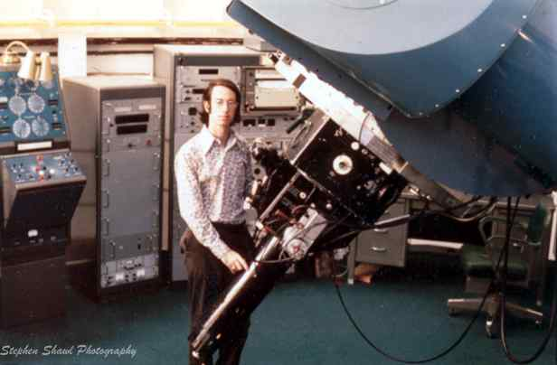
Dissertation research
BA Astronomy Berkeley
PhD Texas Austin
Observations and models of polarization in late-type stars
Observe polarization at LPL telescope on Mt. Bigelow, AZ
Observe spectra at KPNO
Writing fall/spring 1971/72
Apply for jobs

Slide 3
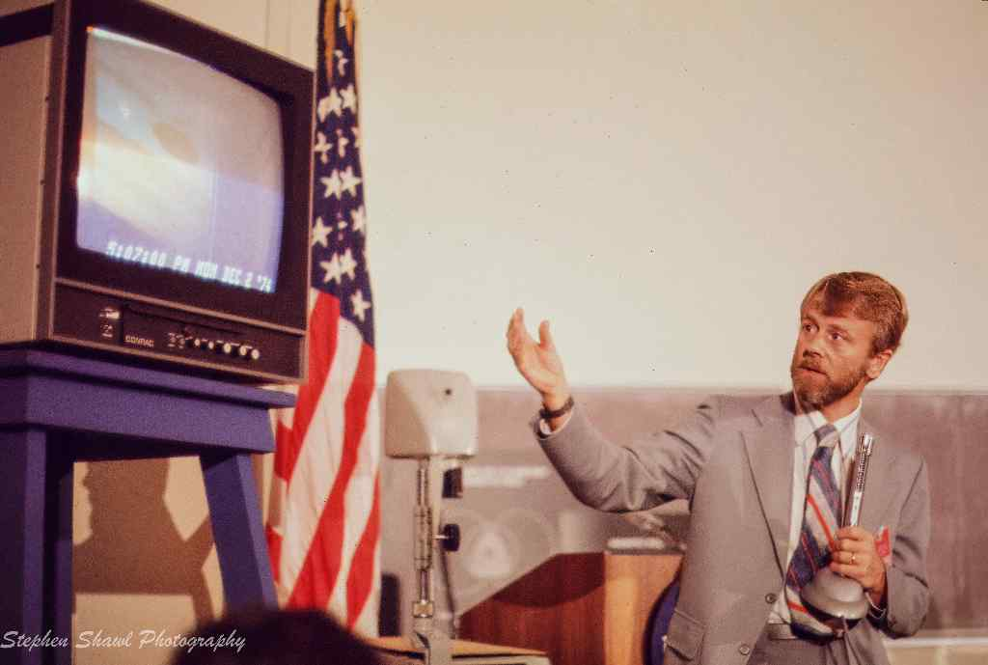
Notes:
Asteroids
Wavelength dependence of interstellar polarization
PI Pioneer Jupiter photopolarimeter
SpaceWatch: earth-crossing asteroids

Slide 4
Job market in 1972
Background in applying
  Berkeley
  KPNO
  UA/LPL
  Papers
No significant teaching experience
No post-doc
Notes:
Berkeley: Spinrad
KNPO: polarization and IR
UA/LPL: observing

Slide 5
KU application
Job market
Knew little about KU; I knew chairman (David Beard) would be at AAS meeting in San Juan, Puerto Rico and I’d talk to him there.
Meeting…
Others who applied
Call from Tom Armstrong
Interview
Offer
  Why me out of all applicants?
Notes:
Thom Gandet going to KU from Tucson
In 1970, offered job to Tom Lutz who turned it down; then hired Peter Wehinger (Sue Wykoff)
1971: Yojo Kondo, Ted Gull, Ed Schmidt

Slide 6
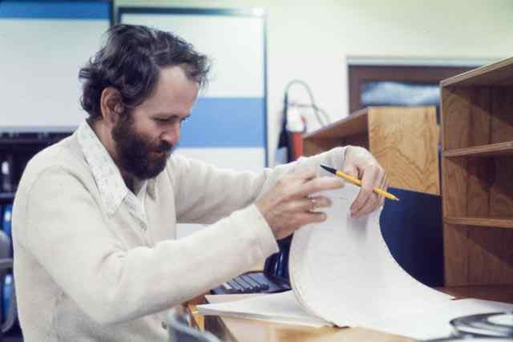
`
Notes:
KU Grad 1963

Slide 7
Summer 1972
Summer day job
Summer night job
August…
Notes:
Day job: Captain US Army
Night job was preparing for 2 classes
First day…Assigned office; told go to Oliver Hall to do freshman advising for the week!

Slide 8
Fall 1972
Astr 191
Astr 691
  Steve Hawley
  Ron Snell
  Ron Gilliland
  Tom Chester
  Gary Westergren
  Joe van Zandt
Notes:
Students in 691: Steve Hawley, Ron Snell, Tom Chester, Ron Gilliland, Gary Westergren, Joe vanZandt
Hawley: we all know!!!
Snell: Chair at U Mass; 1986 AAS’ Newton Lacy Pierce Prize for young observational astronomer;
Gilliland awards: 2007 Gruber prize in cosmology; 2012 Tinsley Prize; 2015 Breakthrough prize in fundamental physics
Chester: Princeton PhD, CalTech Kip Thorne

Slide 9
Some earlier history
Wyman Storer
Henry Horak
The Dean…
The Chairman…
Notes:
Storer: PhD Lick Observatory: 35 years
Horak: U Chicago under Chandra (Nobel laureate); obit in Physics Today (he was a Chess Master and played baseball (pitcher) for the Denver Bears. 17 years at KU then left in disgust for Los Alamos
Dean: George Waggoner, English Professor, hated astronomy; if no PhD program no reason for BA and PhD over his dead body; dean for 21 years!
Chairman: J.D. Stranathan, 23 years as chair…faculty not having key to shop store room

Slide 10
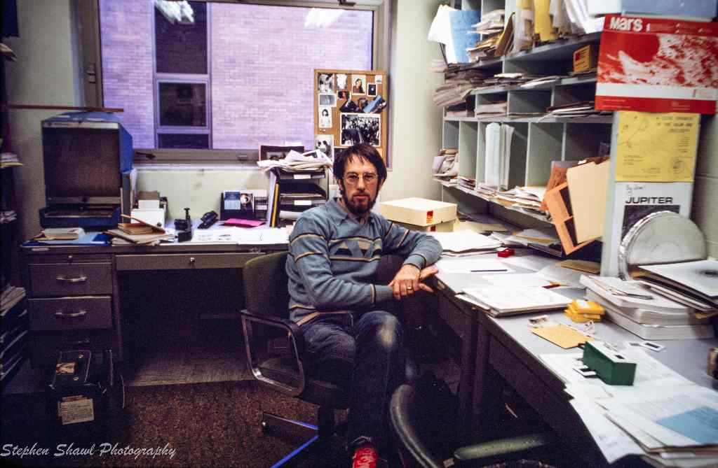
Notes:
Microfiche reader; got ApJ and AJ that way for a few years!!

Slide 11
Later students
Lori Allen
Humberto Campins
Stuartt Corder
Nathan DeLee
Mark Everett
Dick Henry
Lindley Johnson
Adam Kraus
Jackie Milingo
Dan Nunes
Jeff Robertson
Joe Shields
Dave Tholen
Notes:
Lori: past director of MidScale Observatories (KPNO, CTIO)
Stuartt: deputy director NOIRlab
Humberto: started planetary science at CFU
Lindley: Planetary Defense NASA
Jackie: Maria Mitchell Observatory
Joe: director LBT

Slide 12
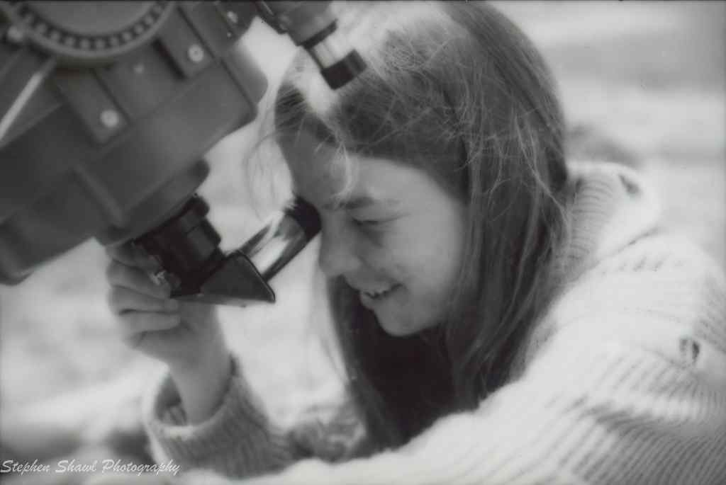
Lori Allen

Slide 13
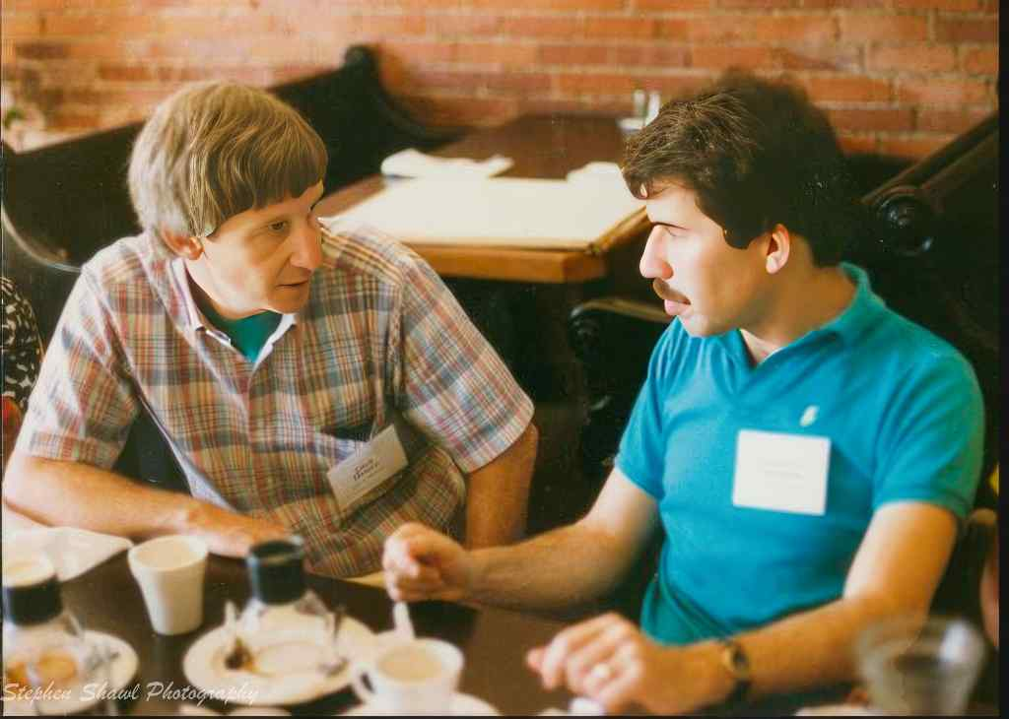
Dick Henry & Humberto Campins
Notes:
Humberto Fall 1973
Dick’s story…

Slide 14
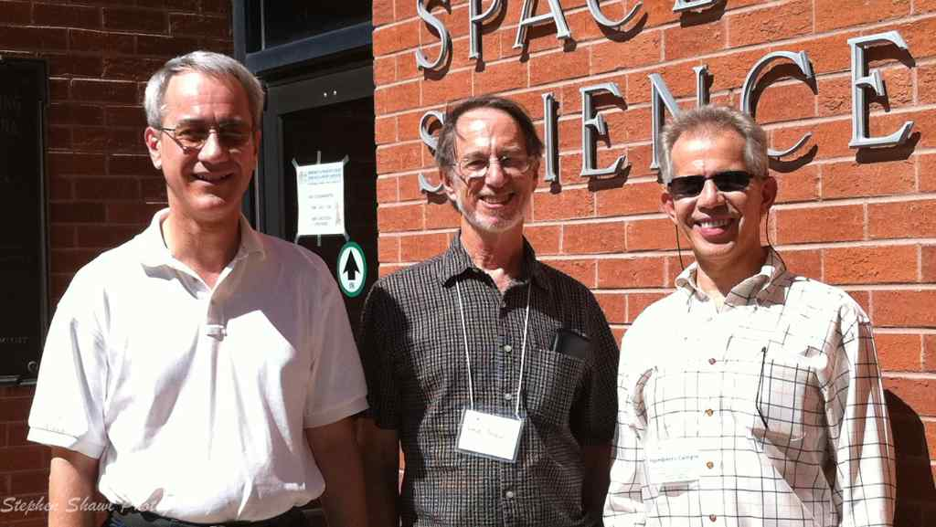
David Tholen & Humberto Campins

Slide 15
KU Observatory

Slide 16
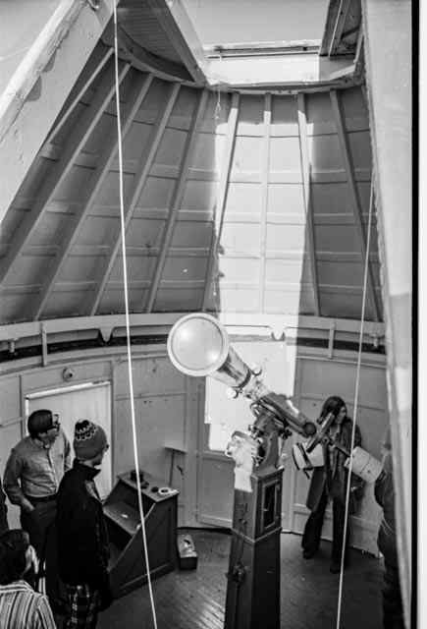
Notes:
Old Clarke dome. Cloth covered.

Slide 17
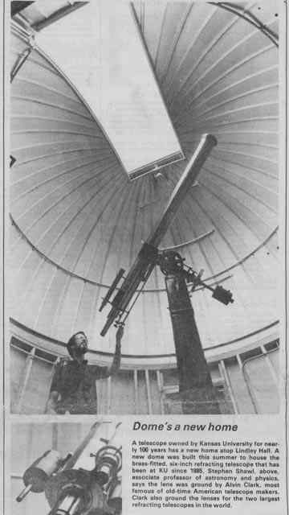

Slide 18
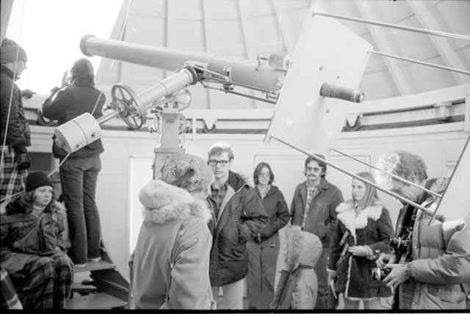

Slide 19
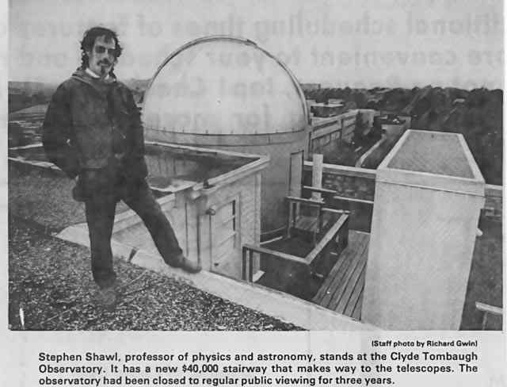
Observatory

Slide 20
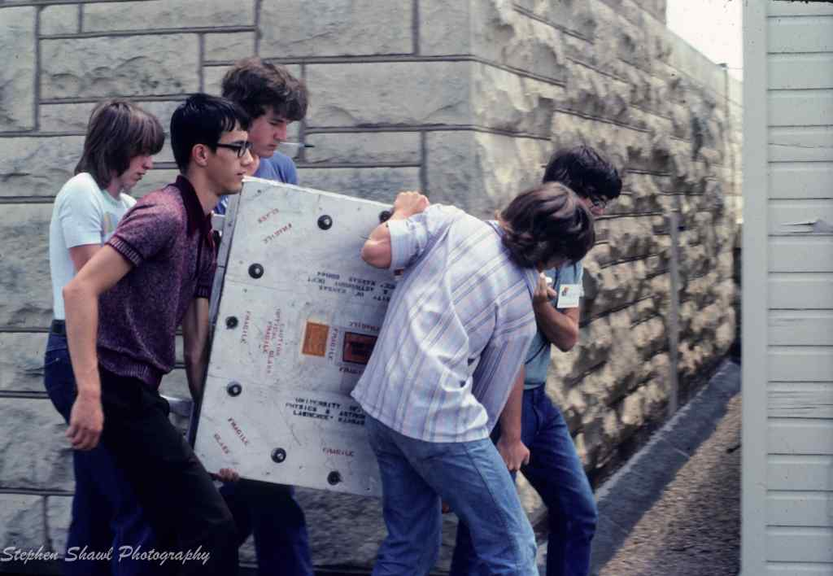
Notes:
Dave Tholen: 1990 Harold Urey Prize; The prize recognizes and encourages outstanding achievements in planetary science by a young scientist.

Slide 21
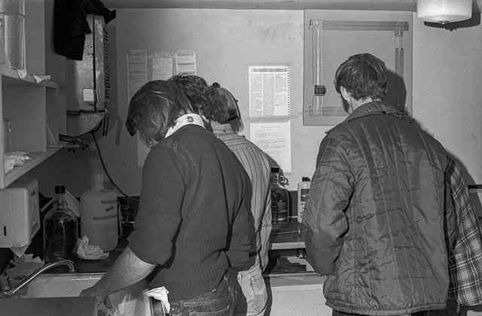

Slide 22
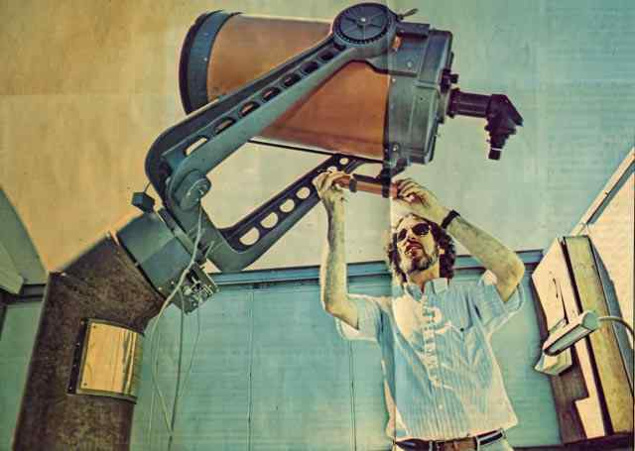

Slide 23
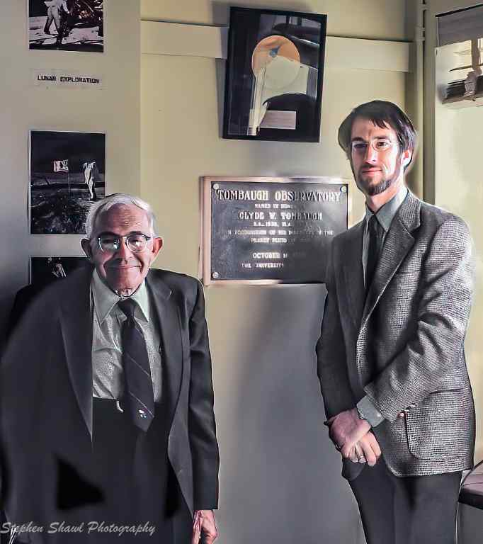

Slide 24
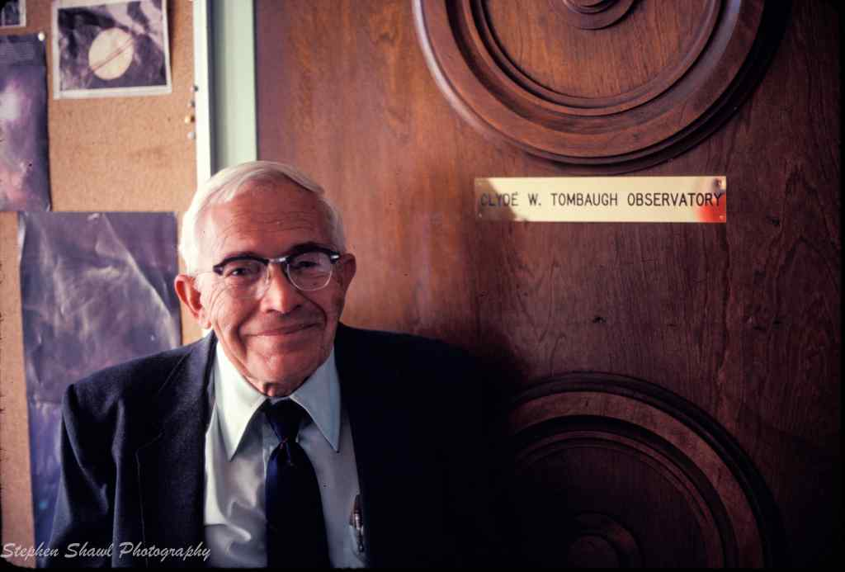

Slide 25
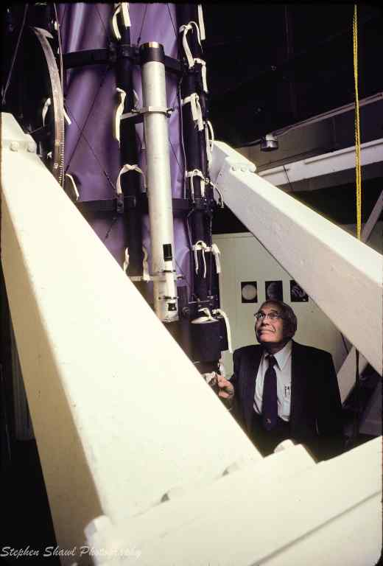

Slide 26
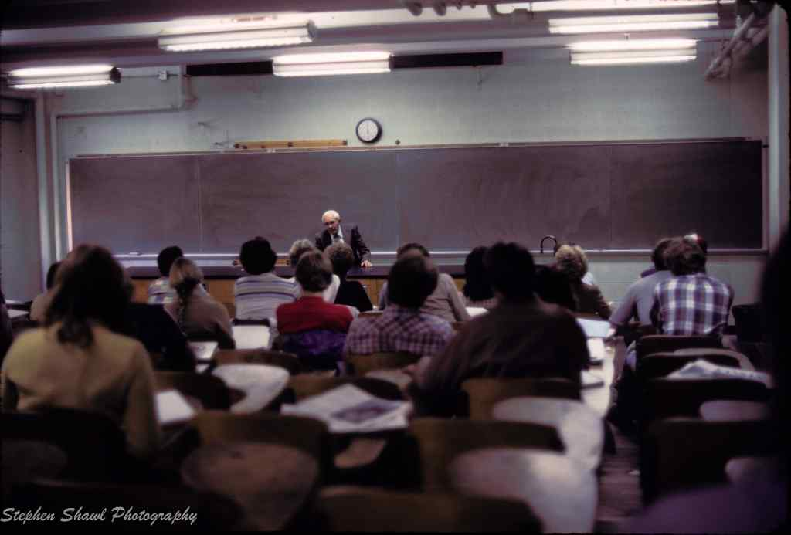

Slide 27
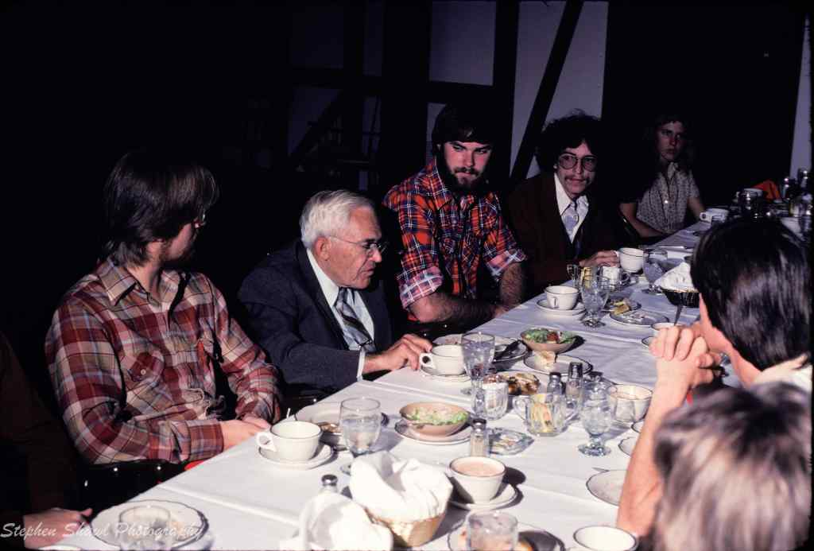
Notes:
Jim Hammer
Chris Brungardt
Tom ???

Slide 28
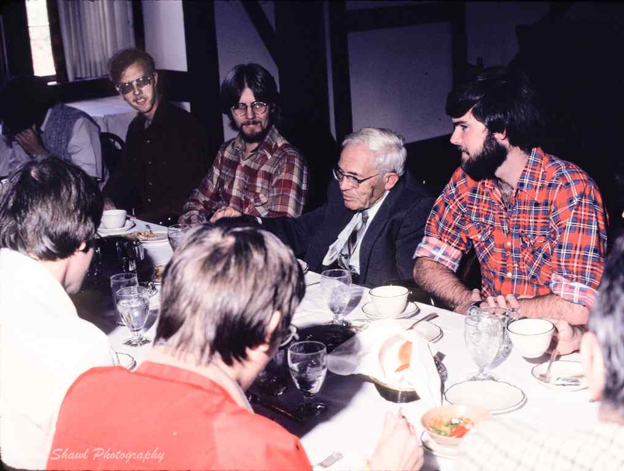
Notes:
Merle Reinhardt: StSCI

Slide 29
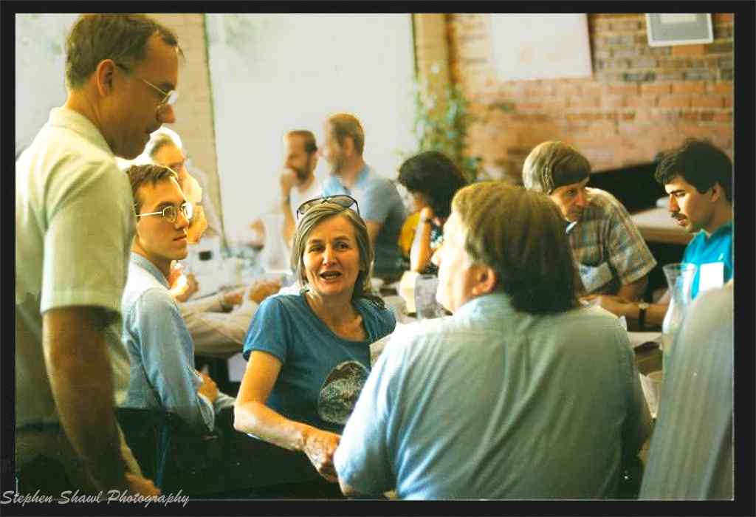

Slide 30
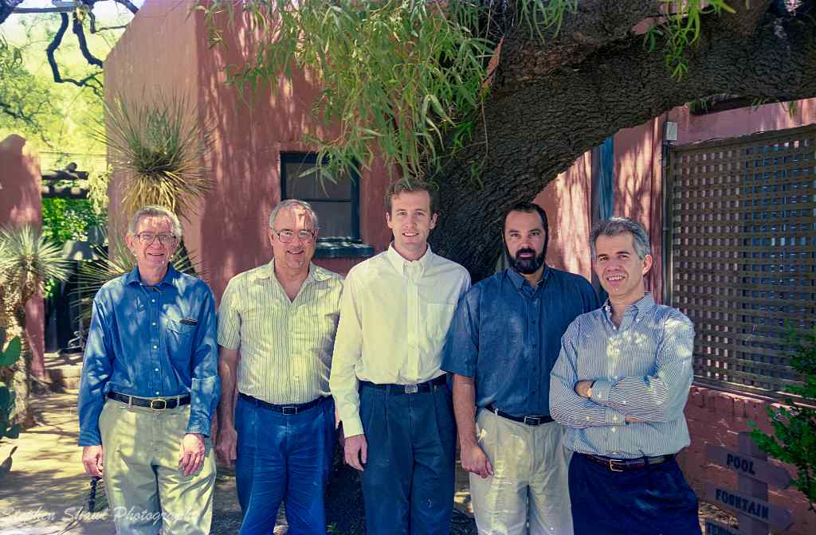
Notes:
Humberto, Bret Goodrich, Mark Everett, Jim Liebert. (Bruce Barrett ~1961)

Slide 31
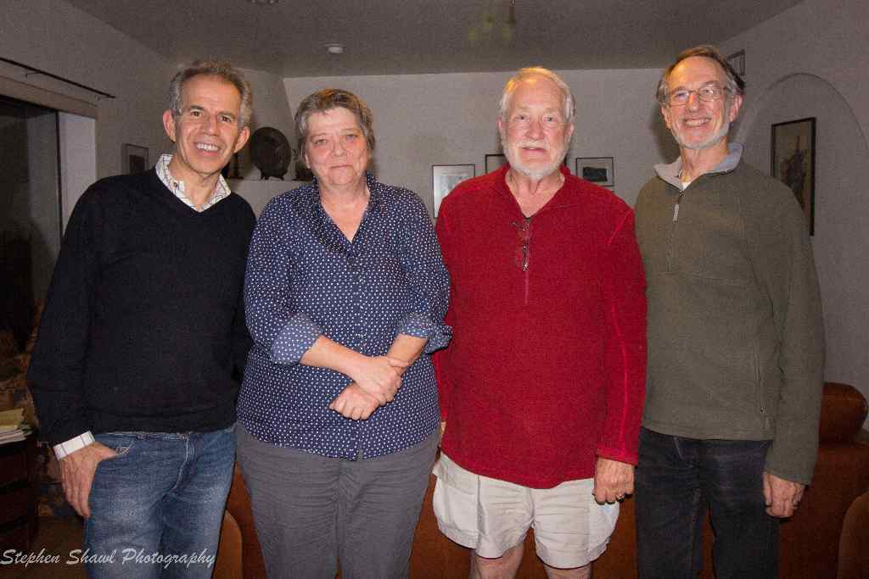
Notes:
Steve Little: KU BA 1961?, MA 1963

Slide 32
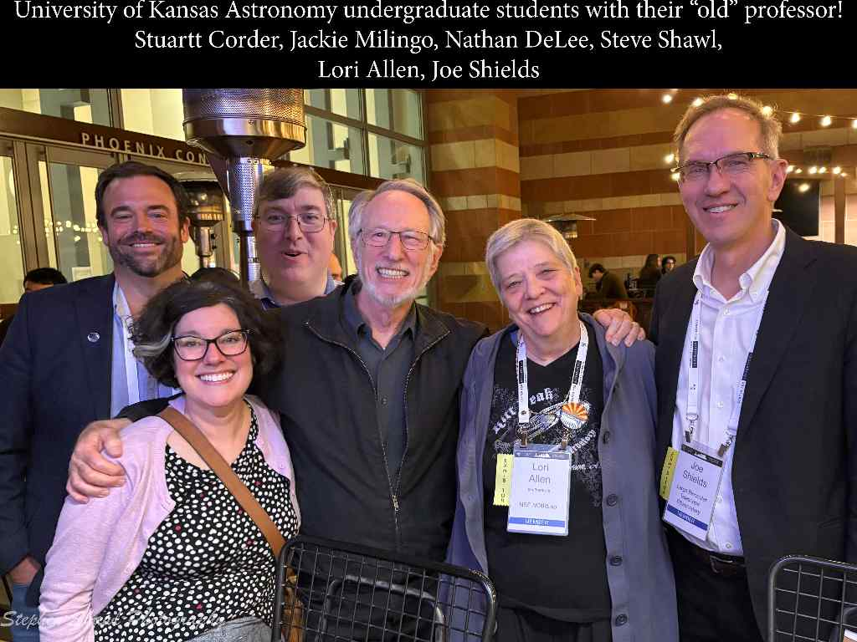

Slide 33
Miscellaneous

Slide 34
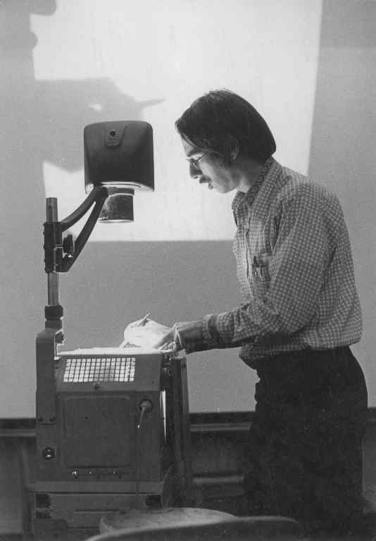

Slide 35
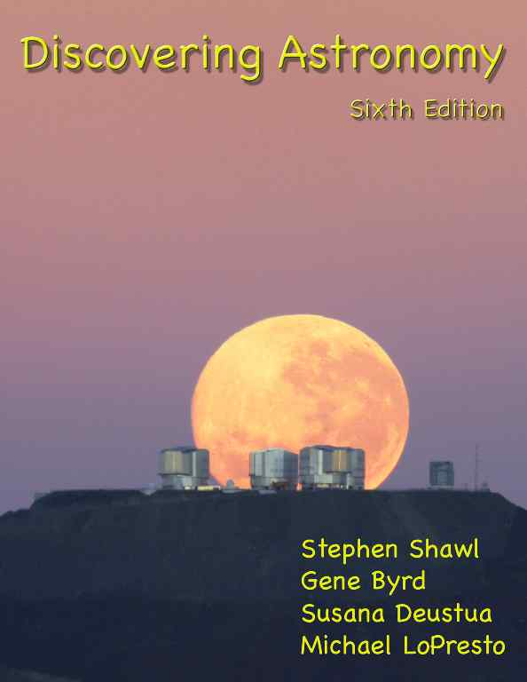

Slide 36
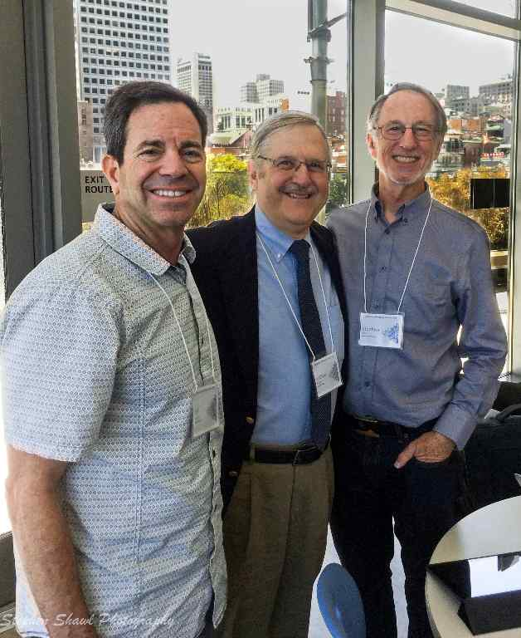
Notes:
Jeff Bennett
Andy Fraknoi…OpenStax

Slide 37
Technique advances

Slide 38
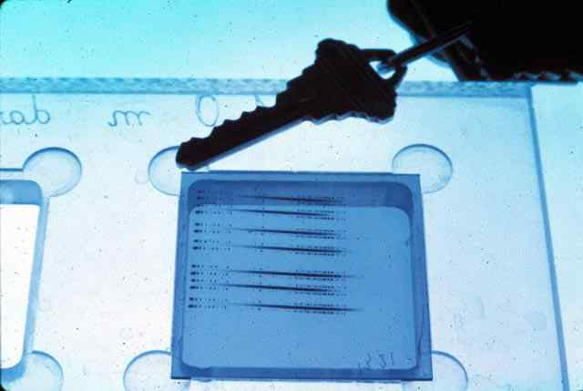

Slide 39
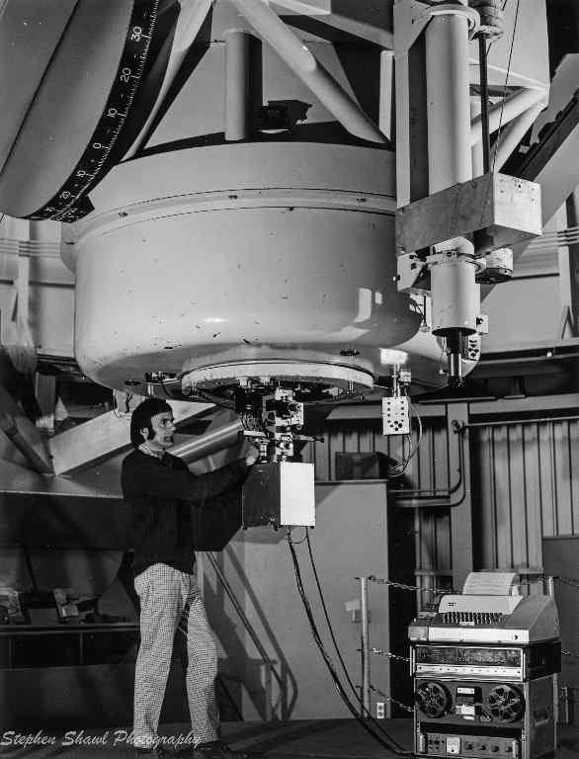

Slide 40
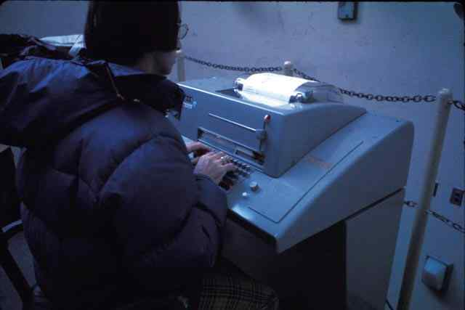

Slide 41
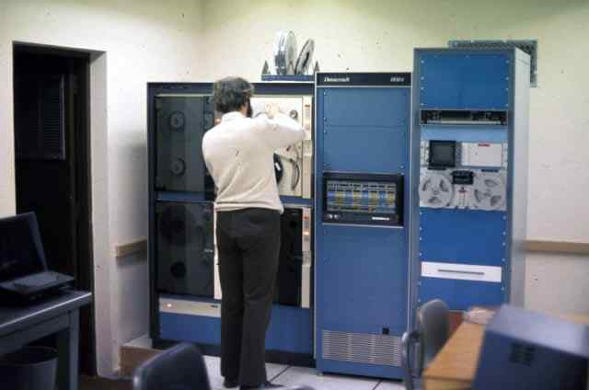

Slide 42
Miscellaneous

Slide 43
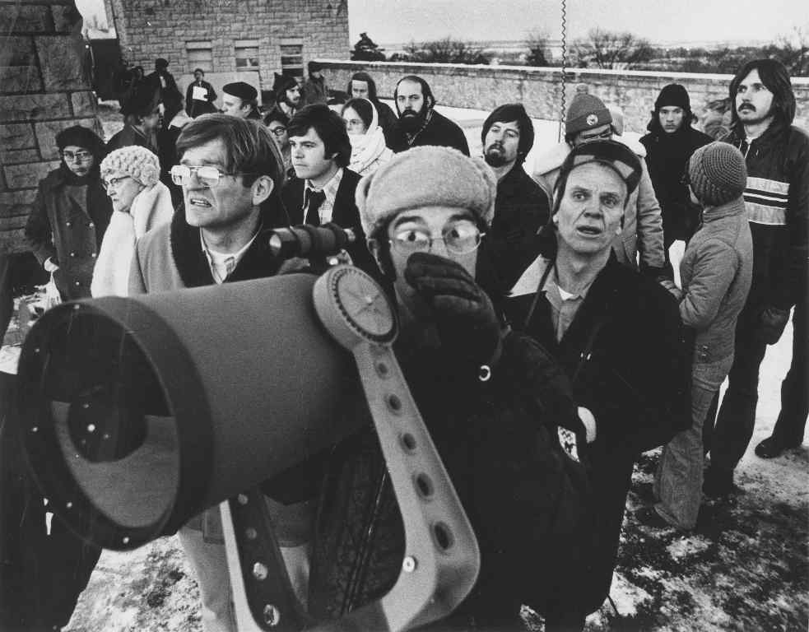
Notes:
1973 Comet Kohoutek

Slide 44
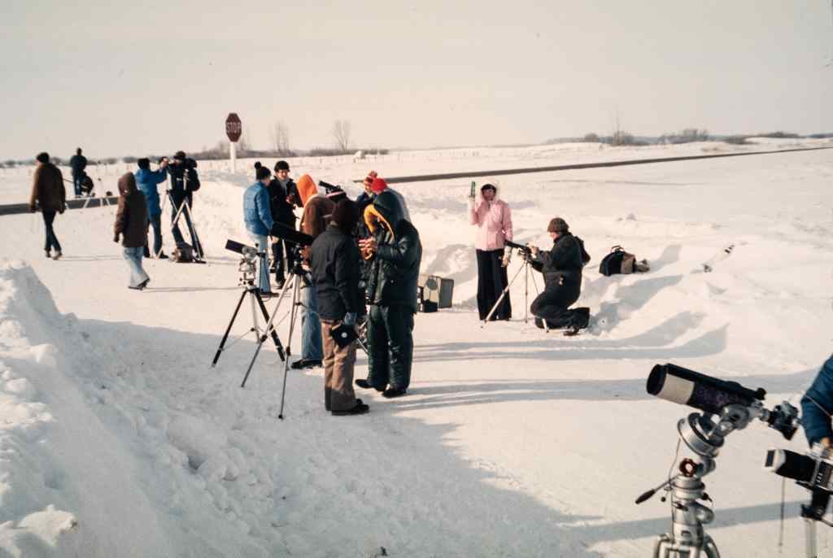

Slide 45
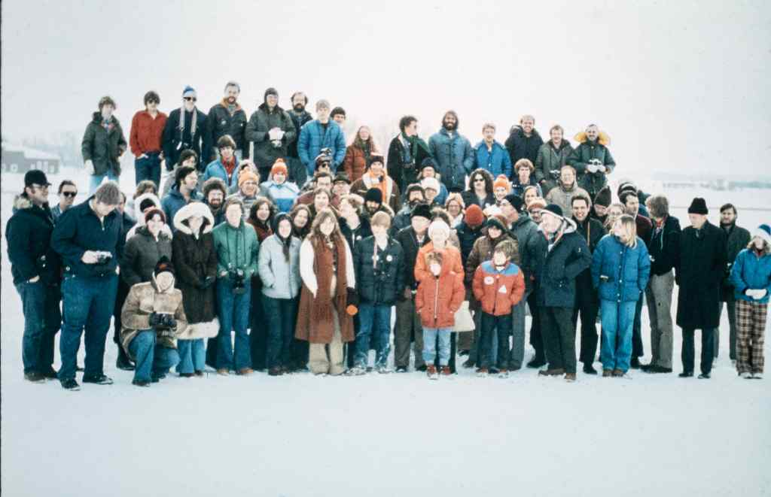
Notes:
Feb 1979, Brandon, Manitoba

Slide 46
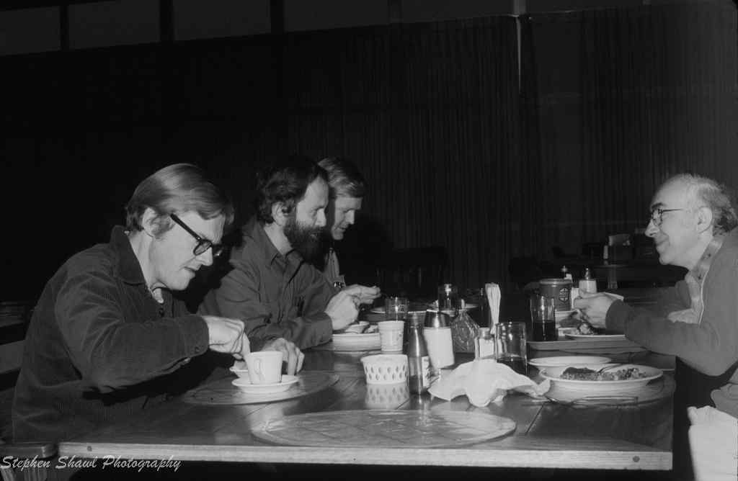
Notes:
Howard Bond, Jim Hesser, Bill Liller, Arlo Landolt

Slide 47
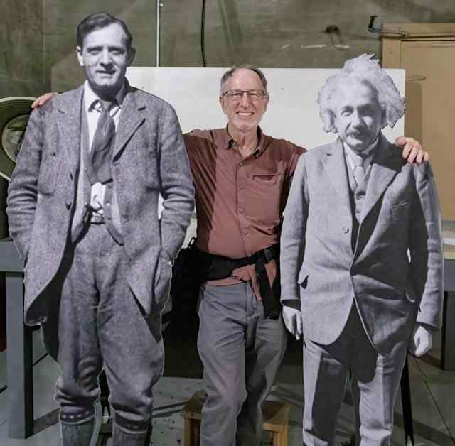

Slide 48
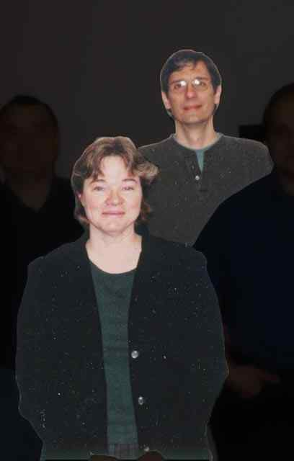
Times getting better! 1982
Notes:
Met at Kitt Peak and encouraged them to apply!
Role of Jack Davidson who didn’t take NO for an answer; Deanelle Tacha
Barb saying that research was more important than teaching!

Slide 49
Times really got better for all…

Slide 50
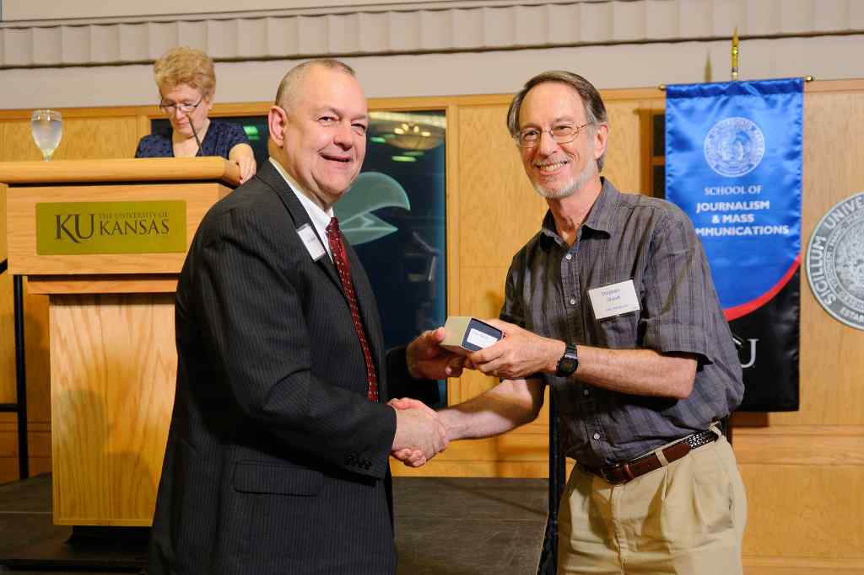
Better yet…

Slide 51
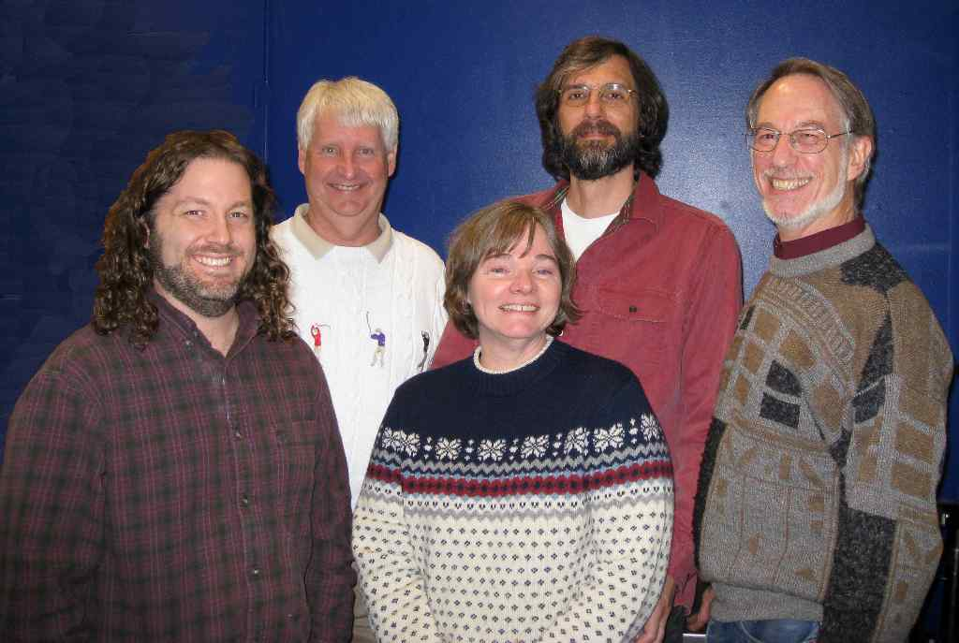

Slide 52
And, finally, now, in addition to Greg…
Allison
Betsy
Ian
Jennifer

